Slide 1

Notice of Employment
ADJUNCT and OVERLOAD
Mark A Walters
HR-Payroll Specialist
956-872-3730 mwalters@southtexascollege.edu
02/27/2020
CH

Slide 2
When to submit an Adjunct NOE
Adjunct NOE’s are used for those Part-Time Faculty employees that DO NOT have a Full-Time Faculty position
Full-Time Exempt Staff teaching assignments are submitted on the Adjunct NOE
Fall, Spring, Summer and Mini-Mesters
Substitute Teaching by an Adjunct Faculty
Full-Time Lecturers in the Summer sessions are considered Adjunct

Slide 3
When to submit an Overload NOE
Fall and Spring
An Overload NOE is used to process payment for additional LHEs beyond 15.
Summer Sessions
All LHEs taught in the summer by full-time regular faculty.
Substitute teaching by a full-time faculty
Full-Time lecturer teaching assignments in the summer are considered Adjunct
Additional payments for large classes or extra class days should be submitted separately on a regular NOE form with justification. Use LARGE CLASS PAYMENT as the position title.

Slide 4
When to submit an Overload NOE Continued
Do not combine classes from different sessions onto the same form
Do not list the instructor’s entire course load on the form. List only the courses the payment refers to. Back-up documentation may list all course load but do not include on NOE
Overload forms can only be used for full-time faculty overloads. Teaching or substitute assignments for other full-time staff such as counselors should be submitted on adjunct NOE forms

Slide 5
Revisions
Submit a photocopy of the NOE in red ink, and do the following:
Check box – Revised
Write the date of the revision
Line through the original information and write the updated info on top
Chair must initial each change
If LHEs increase, get approvals as necessary
If the change results in less pay for faculty, please notify HR/Payroll immediately to coordinate the time. Sometimes a scanned copy may be necessary depending on how close it is to the payroll deadline
Void NOE – Mark a line across the entire page in red, initial and date
If additional help is needed, please contact the HR/Payroll Office

Slide 6
Revisions Continued
Changes in LHEs, dates or any other revision must be done in a timely manner. Contact HR/Payroll immediately so that the NOE can be put on hold until the revision is received

Slide 7
NOE Deadlines
Adjunct and Overload NOE’s are due on the 7th class day of each semester
All sections of the NOE must be completed prior to submitting to the HR/Payroll office
All NOEs for mini-mesters must be turned in by the 15th of the month. If submitted after, payments will begin the following month. Not best practice as employees need to be paid timely

Slide 8
Compensation dates
FALL – September to December
SPRING – February to May
Summer I and II – The day after grades are due
Summer III – Half in Summer I and Half in Summer II

Slide 9
Approvals
Adjunct NOE forms require the following:
  Instructor’s Signature
  Program/Department Chair’s Approval
  Division Dean’s Approval
  Vice President for Academic Affairs if the instructor is teaching over 10 LHEs for the semester.
Overload NOE forms require the following:
  Instructor’s Signature
  Program/Department Chair’s Approval
  Division Dean’s Approval
  Vice President for Academic Affairs if the instructor is teaching over 11 LHEs for the semester.

Slide 10
When is an additional approval needed?
Additional approvals from higher levels are needed when an Instructor is the Department Chair, Dean or the Director. The approval must come from the supervisor above that position
Department Chairs, Deans and Directors, etc. can NOT approve for themselves

Slide 11
Payroll Distribution Report
Information for Chairs
Fall and Spring
Chairs must approve all Adjunct and Overload assignments on the PDR
If changes are noted on PDR, contact HR/Payroll and follow-up with proper documentation
Summer
There are no PDRs generated for the summer sessions

Slide 12
11+
Required

Slide 13
10+
Required

Slide 14
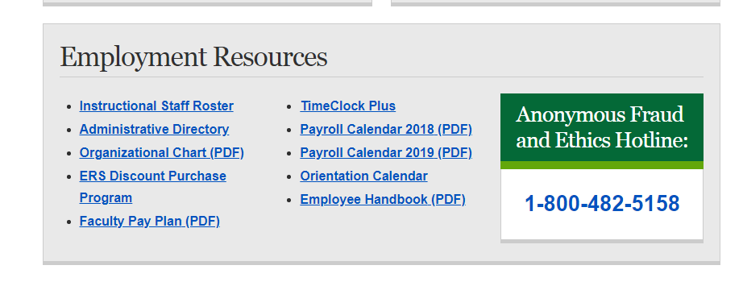
Payroll Calendar
Go to the STC website, click on the Faculty/Staff tab located on top of the page, scroll down and click on the Human Resource tab, scroll all the way down to Employment Resources. (see below)

Slide 16
Reminders
When a full-time faculty is teaching for different departments, use an OVERLOAD NOE if the total load exceeds 15 LHEs. Do not use an Adjunct NOE
A full-time status instructor cannot have a full-time assignment and an adjunct assignment
Any information regarding the calculations for pro-rations should be directed to the Department Chair
Please note that NOEs are due to HR/Payroll PRIOR TO THE ASSIGNMENT START DATE
All approvals must be obtained prior to the assignment start date

Slide 17
Reminders
Any NOEs submitted late should have supporting documentation with an explanation as to why it is submitted late and should be approved by the VPAA prior to submission to HR/Payroll

Slide 18

HR/Payroll Office Contacts
Rosisela Salinas FT Faculty and FT Faculty Stipends 872-5050
Carlos Hernandez FT Staff and Staff Special Stipends 872-3806
Mark Walters Direct Wage, Work Study, Adjuncts 872-3730
and Overloads
Georgina Marr Grant, Auxiliary Staff, Trainers and
Cell Phone Stipends, FLAC 872-3802
Alicia Correa Payroll Manager 872-3815
HR_Payroll@southtexascollege.edu

Slide 19

Questions or Comments

