Slide 1
HUMAN RESOURCES HELPING HANDS PRESENTATION

Slide 2
BENEFITS OVERVIEW
Leave Requests
Virtual Visits
Sick Leave Pool
Leave Without Pay
Unauthorized Absence
Workers Compensation
FMLA
PDR
Temp Agencies
Best Practices for Adjunct Faculty
TCP
New JagNet Information

Slide 3
EMPLOYEE LEAVE REQUESTS
It is imperative that ALL full-time benefit eligible employees submit leave requests in a timely manner for ANY/ALL time away from a scheduled or regular workday.
Request should be entered on TimeClock Plus (TCP).
Timecard must be verified by employee and supervisor on a weekly basis – If you fail to verify and TCP locks you will need to make a copy of the time card and physically sign form and keep in department for 10 years in case of an audit
Timecards will lock every Wednesday at 3:00 pm for the previous week
If leave requests are NOT approved timely, TCP will complete the 40 hours week with a automated UNAUTHORIZED ABSENCE affecting the employee’s paycheck
See the TimeClock Plus Manager/Supervisor Manual

Slide 4
LEAVE DEDUCTION
Non-Exempt Employees:
Vacation and Sick leave are deducted as requested by the employee
Exempt Employees:
Vacation and Sick leave are deducted in 8 hours increments
Any leave requested less than 8 hours should be coded as “Exempt Paid Leave”
Faculty:
Do not accrue Vacation but have the option to use 2 days of the 3 Personal Leave days for Personal Business per fiscal year
Sick leave are deducted in 4 hours increments

Slide 5
VACATION LEAVE - Policy 4306
All Full-Time Benefit eligible employees earn 8 hours a month
All hours of unused accumulated vacation leave must be used before March 1st of the following fiscal year any vacation leave not used by that time will be forfeited
A time extension of not more than 60 days may be granted for extenuating circumstances with the approval of Supervisor, Vice President and President

Slide 6
SICK LEAVE – Policy 4308
All Full-Time Benefit eligible employees earn 8 hours per month
May be used for personal illness of employee or employee’s immediate family
Immediate family, of employee, in this Board policy is defined as:
children
parent
or spouse
Sick leave that is requested for more than 3 8-hours consecutive days must be report to HR Benefits Office
An employee’s supervisor retains the option to request a doctor’s statement for day(s) missed due to illness

Slide 7
FUNERAL LEAVE – Policy 4312
May be used for the death in the employee’s immediate family.
Under this Policy, the employee’s immediate family is defined as the employee’s and the spouse’s:
Parents,
Children
Brothers
Sisters
Grandparents
and Grandchildren
May use a maximum of 3 days (24 hours) which are to be taken from sick or vacation hours, or taken as leave without pay.

Slide 8
PERSONAL LEAVE – Policy 4311
Employees may use up to a maximum of 3 days of accrued Sick leave during any fiscal year as Personal Leave for:
Funerals not covered under funeral leave immediate family
Religious observances not on the approved College calendar
Sick leave for persons outside the immediate family
Leave requested will be subtracted from sick leave otherwise must be requested from vacation
All Personal Leave is tracked; if overused, employees will receive a doc in their pay
All personal leave is required to be approved in advance
FACULTY ONLY: Personal Business (2 day per fiscal year) eff. July 1, 2014

Slide 9
EDUCATIONAL ACTIVITIES LEAVE – Policy 4230
You may use up to 8 hours of accrued sick leave each fiscal year to attend an educational activities of the employee’s child who is a student attending a grade from prekindergarten through 12th grade.
An educational activity is defined as a school-sponsored activity, including a parent-teacher conference, tutoring, a volunteer program, a field trip etc….
Employee shall give reasonable advanced notice of intention to use the sick leave to attend an educational activity.

Slide 10
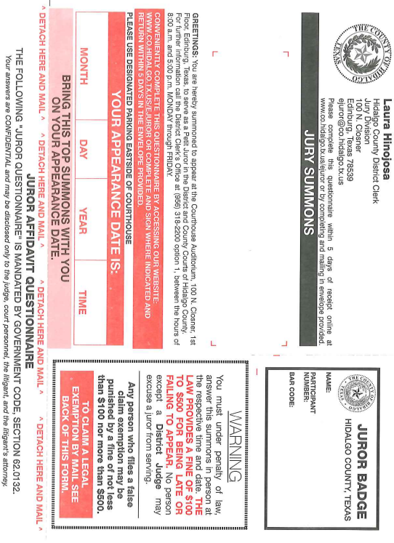
JURY AND WITNESS DUTY – Policy 4314
Any employee holding a staffing plan position
Employees may retain any fees paid by the court.
Employees are expected to return to work upon release from jury duty, if during normal work hours.
A jury summons from must be scanned and emailed to hr_benefits@southtexascollege.edu or mailed to the Office of Human Resources.

Slide 11
VIRTUAL VISITS

Slide 12
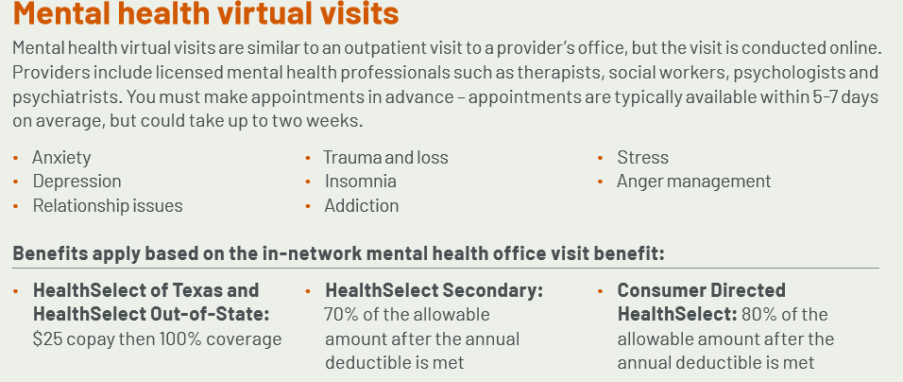
VIRTUAL VISITS (CONT’D)

Slide 13
SICK LEAVE POOL – Policy 4310
Must be full-time and have completed 12 calendar months of employment.
Must have accrued a minimum of 72 sick leave hours accrued.
Enrollment Periods are April and October.
Initial enrollment donation of 24 hours (8 hrs automatic donation every year after, unless discontinued).

Slide 14
LEAVE WITHOUT PAY LEAVE – Policy 4316
Leave without pay may be granted for up to 12 months subject to the following provisions:
Except for disciplinary suspension, parental leave, family and medical leave, workers' compensation and military situations, all accumulated paid leave entitlement must be exhausted before granting leave without pay, with the additional provision that sick leave must be exhausted only in those cases where the employee is eligible to take sick leave under sick leave provisions.

Slide 15
UNAUTHORIZED ABSENCE– Policy 4511
In the case of an unauthorized absence being an unexcused absence or an absence where the employee has not notified the supervisor in accordance with established procedures, the employee's pay will be docked for the amount of time absent.
Disciplinary action may be initiated when necessary. An unauthorized absence of greater than 2 days may be treated as a voluntary resignation from employment with the College.
TCP will generate an unauthorized absence if an employee does not meet the 40 hours, however, it does not populate it to the day that the absence occurred.

Slide 16
MILITARY LEAVE – Policy 4317
An employee may take a paid leave of absence of not more than 15 workdays in a fiscal year to perform temporary active duty with Reserve or National Guard units. During such leave of absence and while engaged in the performance of such military duty.
The College shall carry forward from one fiscal year to the next the net balance of unused accumulated leave under the Short Term Military Leave available not to exceed 45 workdays.
A copy of the official military orders must be attached.
Notify HR if a deployment may be foreseen.
Direct-Wage employees are entitled to 57 hours of Military Leave

Slide 17
WORKERS’ COMPENSATION
What to do in the event of a work-related illness or injury:
Report IMMEDIATELY to your supervisor
Contact Cindy Rocha, Benefits Specialist at 872-5011
Fill out First Report of Injury Form, which is found in the Human Resources web site.
If the employee is unavailable to complete the Incident Report, the supervisor should complete the form.

Slide 18
FMLA- Family Medical Leave Act
Employee must have been employed for at least 12 months (PT/FT).
Must have worked 1250 hours in the year prior to request.
Eligible employees are entitled to 12 weeks of leave during any twelve month period due to:
Birth of a child
Adoption or foster care
To care for employee’s spouse, son, daughter or parent with a serious health condition
Because of an employee’s own serious health condition
Any qualifying exigency (as governed by federal regulations promulgated by Dept of Labor) arising out of the fact that the spouse, son, daughter, or parent of the employee is on active duty (or has been notified of an impending call or order to active duty)
To care for spouse, son, daughter, parent, or next of kin of a covered service member who is recovering from a serious illness or injury sustained in the line of duty on active duty. Entitled to up to 26 weeks of leave in a single 12-month period to care for the service member. (Eligible employee is entitled to a combined total of 26 weeks of all types of FMLA leave.)

Slide 19
What is the first step?
Whenever an eligible employee’s leave is foreseeable or is out for More Than 3 Days (sick leave).
Employees/department will need to contact HR to begin the process.
The Family Medical Leave Request needs to be completed and forwarded to the Office of Human Resources
The application must include the required Medical Certification from the health care provider of the eligible employee, child, spouse, or parent as appropriate.
If approved, medical certification must be submitted to the Office of Human Resources within 15 days of receipt of employer response.

Slide 20
Department Roles
Department is notified
For TCP users, HR will complete timecard with FMLA leave used
Employee is sent hard copy of timecard for signature, then it is forwarded to supervisor
Supervisors will sign leave forms and return to HR in a timely manner
Supervisors will need to continue to approve timecards in TCP.
HIPAA privacy laws state it’s recommended the supervisor have minimal contact while the employee is out in FMLA leave.**
All communication will be handled by Human Resources.

Slide 21
Intermittent Leave
Leave taken for the birth, adoption, or foster care of son or daughter can be taken intermittently or on a reduced leave schedule upon agreement between employer/employee.
Leave taken for a serious health condition or a serious injury or
Illness of a covered service member may be taken by an employee intermittently or on a reduced leave schedule when medically necessary.
HR will send the employee a Modified Work Schedule to be reviewed by the department. Signed by the Supervisor and returned to HR in a timely manner.
Employee is REQUIRED to follow set schedule and advise HR and Supervisor if schedule will be changed.

Slide 22
Returning To Work
Before Returning to Work:
We REQUIRE a Doctors Release Notice.
HR will notify supervisor when employee will return to work or continue to be out.
Light Duty – May or May NOT be approved depending on the job position.
EXAMPLES:
Secretary – No Climbing: May be accommodated
Custodial – Limited Walking: May NOT have light duty available

Slide 23
New Rights of Nursing Mothers to Express Breast Milk in the Workplace
The College supports the rights of nursing mothers in the workplace in compliance with State and Federal Laws.
An employee shall be provided with a reasonable break time and a reasonable space for the employee to express breast milk for up to one year from the child’s birth.

Slide 24
PDR- Payroll Distribution Report
Supervisors are expected to approve their employees monthly payment via JagNet.
Review that Exempt Staff worked the month
Anyone that Terminated is appearing only because they are getting paid their overtime/straight time/vacation settlement.
Approve employees out on FMLA/WC.
This is needed to PREVENT overpayments.

Slide 25
Temporary Agency Employee Requests
Some things to remember:
It takes approximately one week to process a request – please plan ahead.
Avoid overtime for Temporary Agency Employees – contracted hours are encumbered at only 40 hrs/week.
CAN:
Work beyond assignment dates – request an extension, if needed.
Be replaced, for any work-related reason (attendance, failure to abide by policy, etc.).
Apply for full-time positions with the College
CANNOT:
Start work until a PO# has been assigned – NO EXCEPTIONS.
Work when the College is closed (holidays, semester breaks, etc.)
Drive as part of their job duties (running errands, making deliveries, picking up documents, etc.)
CONTACT: HR Staffing Specialist at 872-5012

Slide 26
Best Practices for Adjunct Faculty
If you should have adjunct instructors scheduled to teach 20 or more clock hours per week with the expectation to continue for more than one semester please notify the HR Benefits Staff immediately.
As per Board Policy 4300 A full time benefit eligible employee must be employed to work at least 20 hours per week for a period of at least four and one-half months.
As per Board Policy 3809 maximum teaching load for adjunct faculty will be no more than 10 LHE’s per semester. Any teaching assignment above 10 LHE’S will require written approval from the Vice President for Academic affairs.

Slide 27
https://finance.southtexascollege.edu/businessoffice/timeclock.html

Slide 28
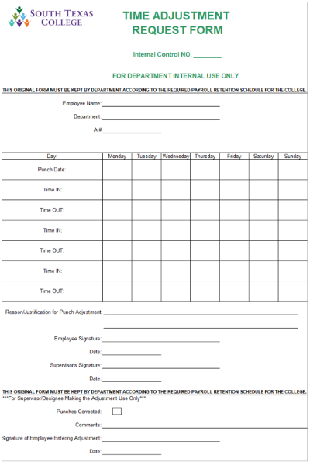
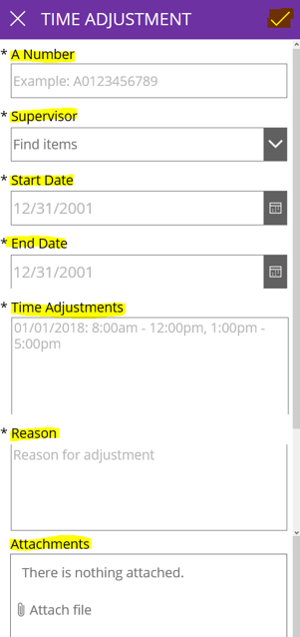
Electronic Time Adjustment Request Form (TARF)
Please contact Elizabeth G.(ext. 4604) or Ana G.(ext. 4629) for additional information

Slide 29
New JagNet Employee Profile

Slide 30
Electronic Change of Address Form

Slide 31
Benefits Staff Contacts
Annel V. Perez Zuniga, Benefits Manager: 872-3804
apere129@southtexascollege.edu
Ana Karen Alanis, Benefits Specialist: 872-3808
aalanis3@southtexascollege.edu
Brianda Gutierrez, Benefits Specialist: 872-3801
bgutier2@southtexascollege.edu
Sergio Trevino, Benefits Specialist: 872-3728
strevino_4825@southtexascollege.edu
For general questions or information, please contact us at
HR_Benefits@southtexascollege.edu

Slide 32
ANY QUESTIONS?

